Slide 1

Model Comparison for Heart Disease Prediction
CIS 490 Machine Learning MT Project Presentation
Kevin D’Cruz (L)
Chetan Kumar
Abhishek Manoj Kumar

Slide 2
Overview
Background
Datasets
Cleveland Heart Disease
Statlog Heart Disease
SPECT Heart Disease
Methods
Logistic Regression
Decision Trees
Neural Networks
Results
Literature Review
Conclusion
References

Slide 3
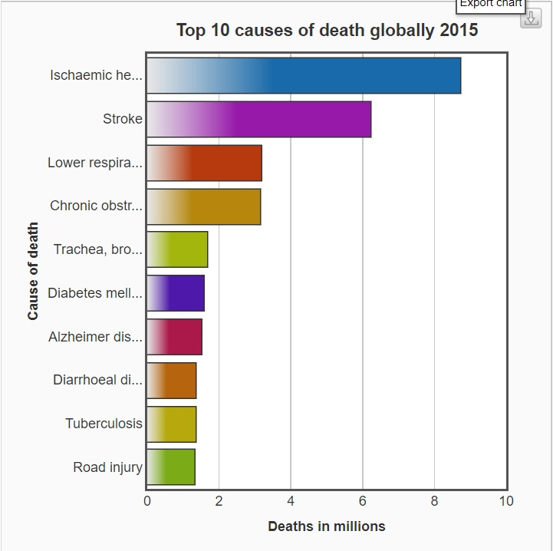
Background
Datasets were picked from UCI Machine learning repository
Similar datasets; all based on heart diseases
Binary Classification: Presence/Absence of heart diseases
Reason for choosing similar datasets:
Checking the consistency of the models across datasets
Find which model was the best, based on different evaluation criteria
Ref: WHO

Slide 4
Cleveland Heart Disease Dataset
Response Variable
age | sex | cp | trestbps | chol | fbs | restecg | thalach | exang | oldpeak | slope | ca | thal | num
63 | 1 | 1 | 145 | 233 | 1 | 2 | 150 | 0 | 2.3 | 3 | 0 | 6 | 0
67 | 1 | 4 | 160 | 286 | 0 | 2 | 108 | 1 | 1.5 | 2 | 3 | 3 | 1
Attributes → 14
Characteristics: Categorical, Integer and Real
Instances →304

Slide 5
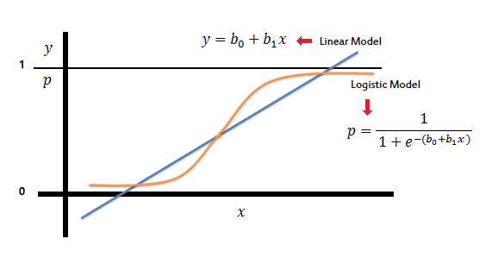
Logistic Regression
Statistical method for analyzing a dataset having one or more independent variables to determine an outcome
Outcome is measured with a dichotomous variable (two possible outcomes)
Having True (1) and False (0)
Why Logistic Regression?
It is used to predict a binary outcome (1 / 0, Yes / No, True / False) given a set of independent variables.

Slide 6
Evaluation Criteria
Dataset Split Ratio
Train (%)
Test (%)
Considering All Vs Significant Independent Variables
Cross Validation
Folds: 5, 10, 15, 20, 25
ROC Curve

Slide 7
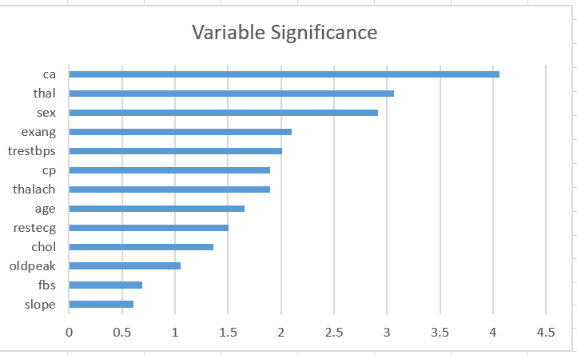
Significant Variables

Slide 8
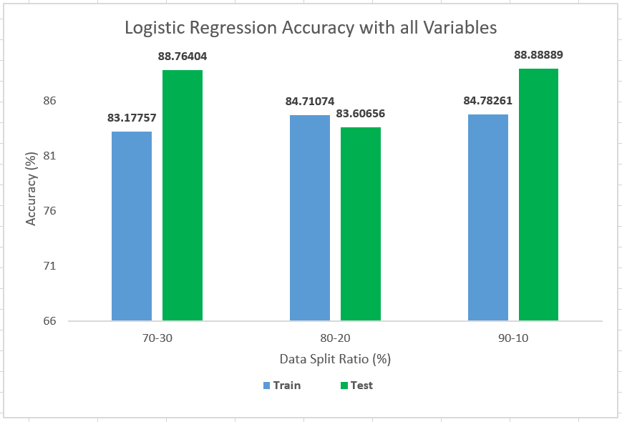
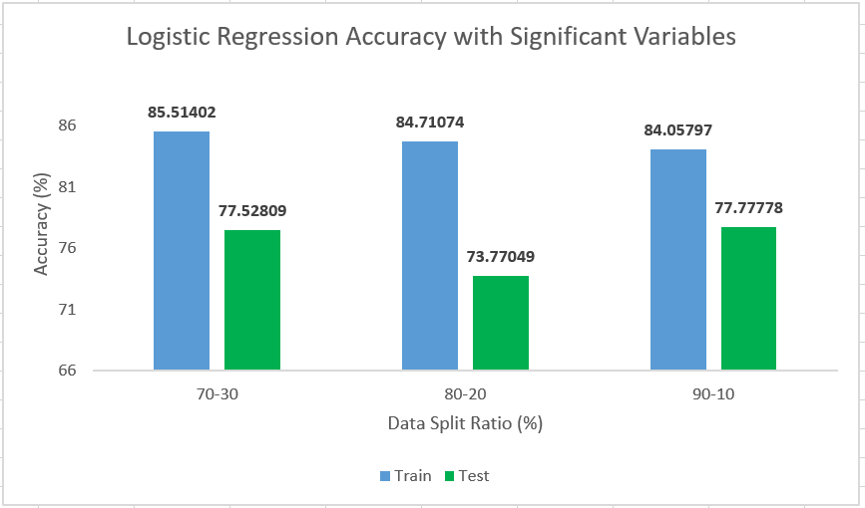
Accuracy: Train Vs Test
All Variables
Significant Variables

Slide 9
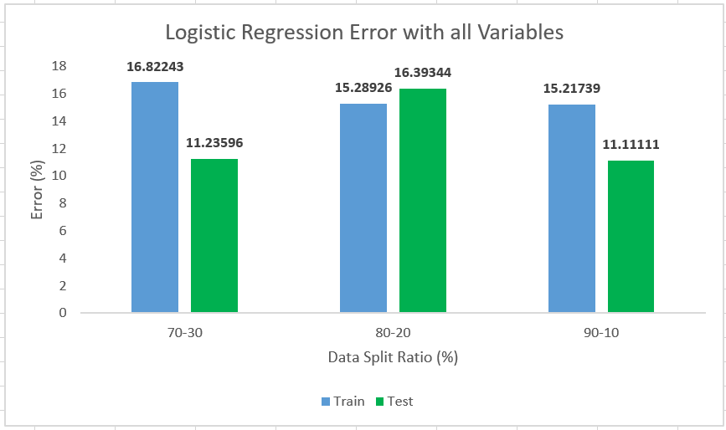
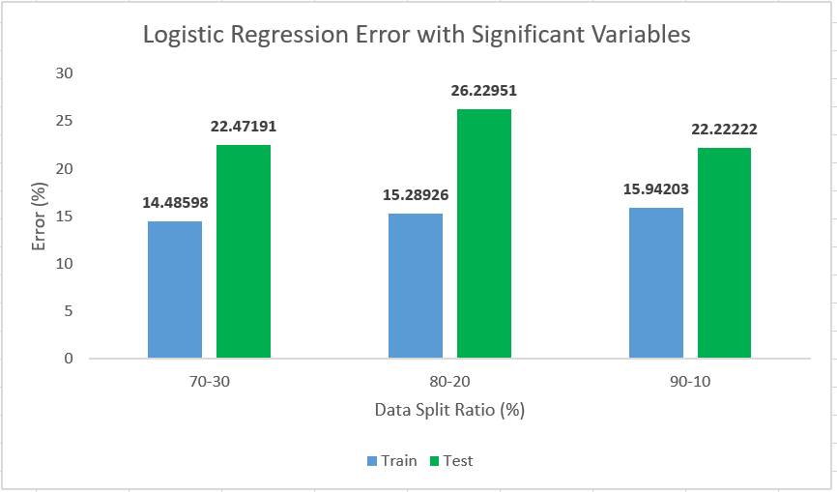
Error: Train Vs Test
All Variables
Significant Variables

Slide 10
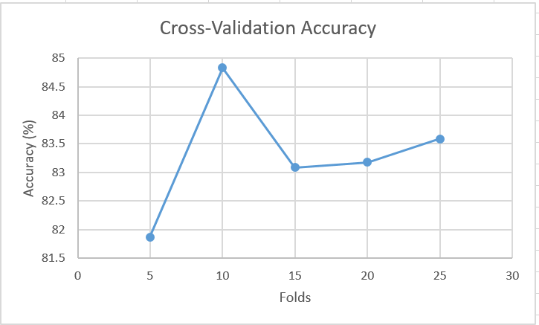
Cross Validation

Slide 11
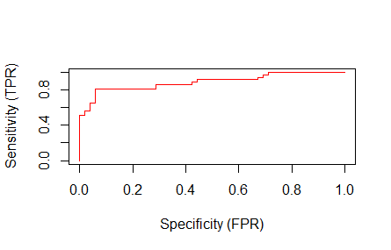
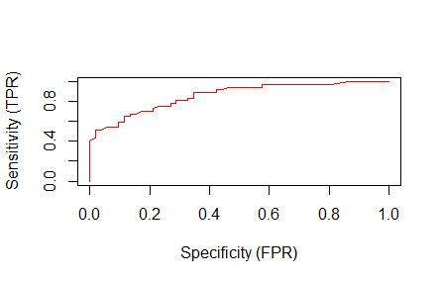
AUC
All Variables
Significant Variables
AUC: 89.13%
AUC: 86.12%

Slide 12
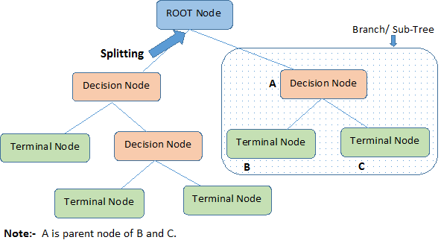
Decision Trees
Decision Trees are graphic module of Decision Matrix Analysis.
A decision tree has three types of nodes: decision nodes, chance event nodes,and terminating nodes.
Why?
Its type of supervised learning
Its type of supervised learning
Works for both categorical and continuous input and output variables.
Works for both categorical and continuous input and output variables.

Slide 13
Evaluation Criteria
Fully Grown Tree
Pruning Tree
Ensemble Learning
Bagging
Boosting

Slide 14
Ensemble Learning
Art of combining diverse set of learners (individual models) together to improvise on the stability and predictive power of the model.
Bagging
Bootstrap Aggregation
Create Bootstrap samples of a training set using sampling with replacement.
Each bootstrap sample is used to train a different component of base classifier
Classification is done by plurality voting
Boosting
A technique for combining multiple base classifiers whose combined performance is significantly better than that of any of the base classifiers
Each classifier votes to obtain a final outcome

Slide 15
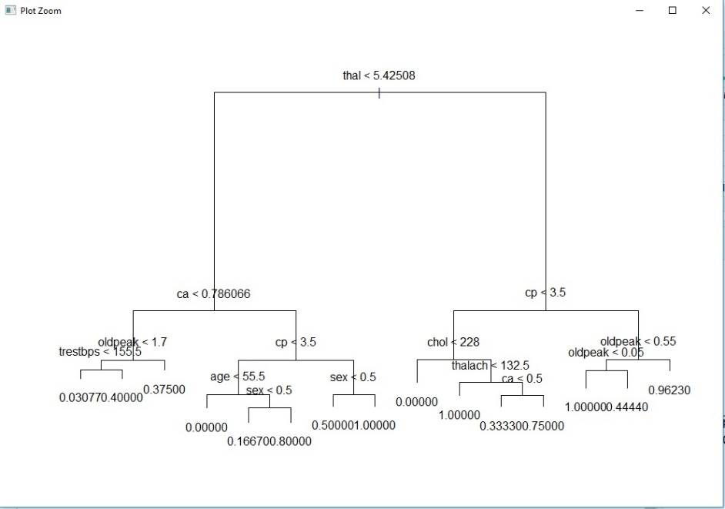
Results
Fully Grown Tree
Error: 20.22%

Slide 16
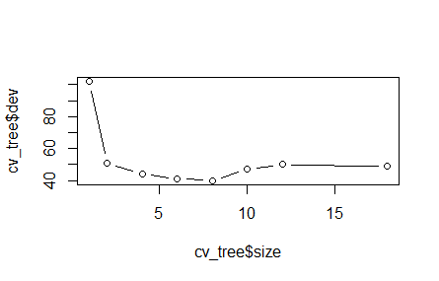
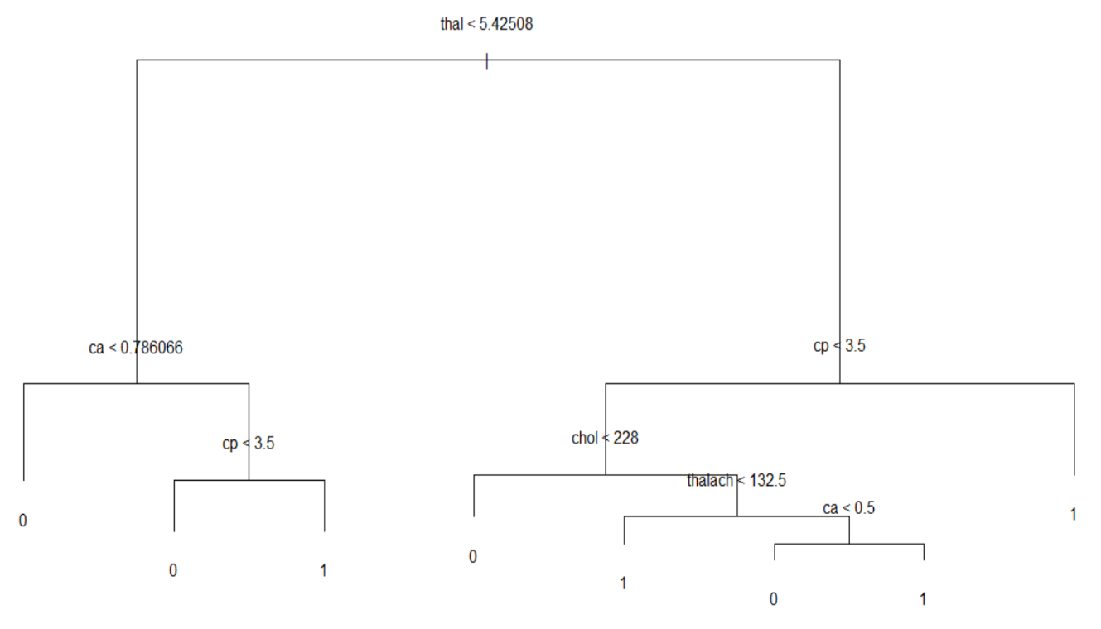
Results
Pruning Criteria
Pruned Tree
Best: 8
Error: 13.08%

Slide 17
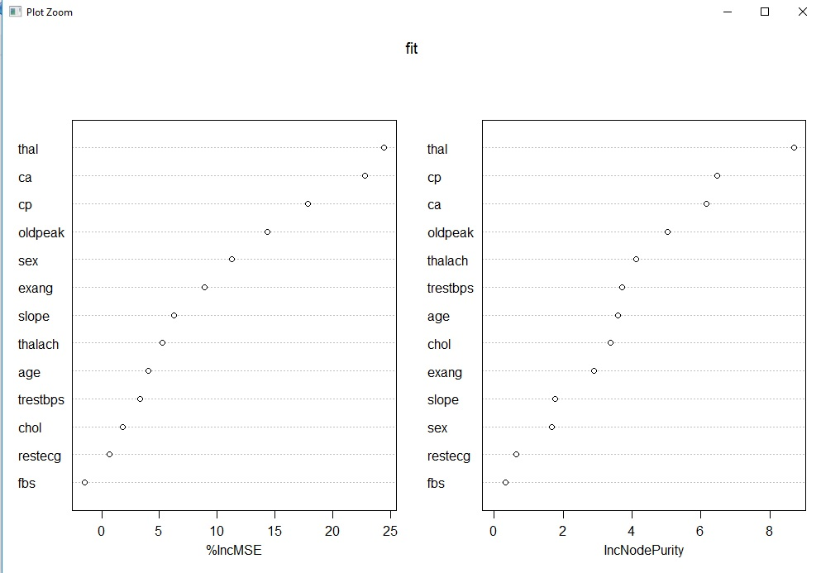
Bagging

Slide 18
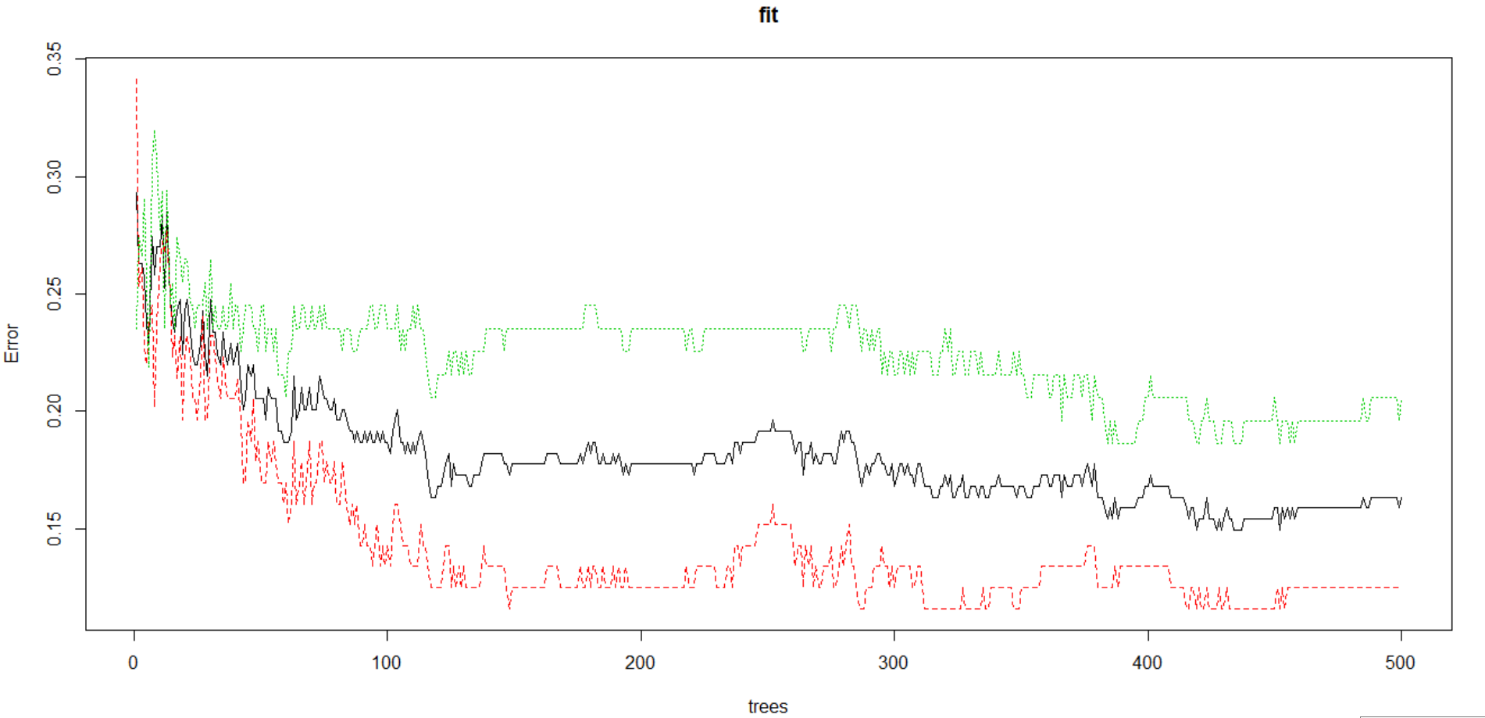
Random Forest (Bagging)
Tree-Size: 500
Error before: 16.39%
Error after: 12.54%
Notes:
https://stats.stackexchange.com/questions/51629/multiple-curves-when-plotting-a-random-forest
When there is no test result (ytest was empty for training), plot shows:
for classification, black solid line for overall OOB error and a bunch of colour lines, one for each class' error (i.e. 1-this class recall).
for regression, one black solid line for OOB MSE erro

Slide 19
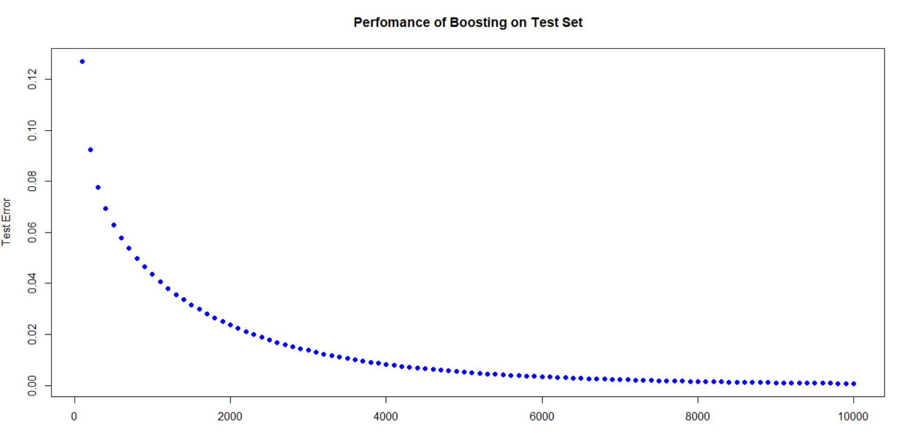
Boosting (Gradient Boosted Model)
100 | 200 | 300 | 400 | 500 | 600
0.127066255 | 0.092458073 | 0.077803787 | 0.06926611 | 0.062968769 | 0.05796503
Notes:
https://stats.stackexchange.com/questions/51629/multiple-curves-when-plotting-a-random-forest
When there is no test result (ytest was empty for training), plot shows:
for classification, black solid line for overall OOB error and a bunch of colour lines, one for each class' error (i.e. 1-this class recall).
for regression, one black solid line for OOB MSE erro

Slide 20
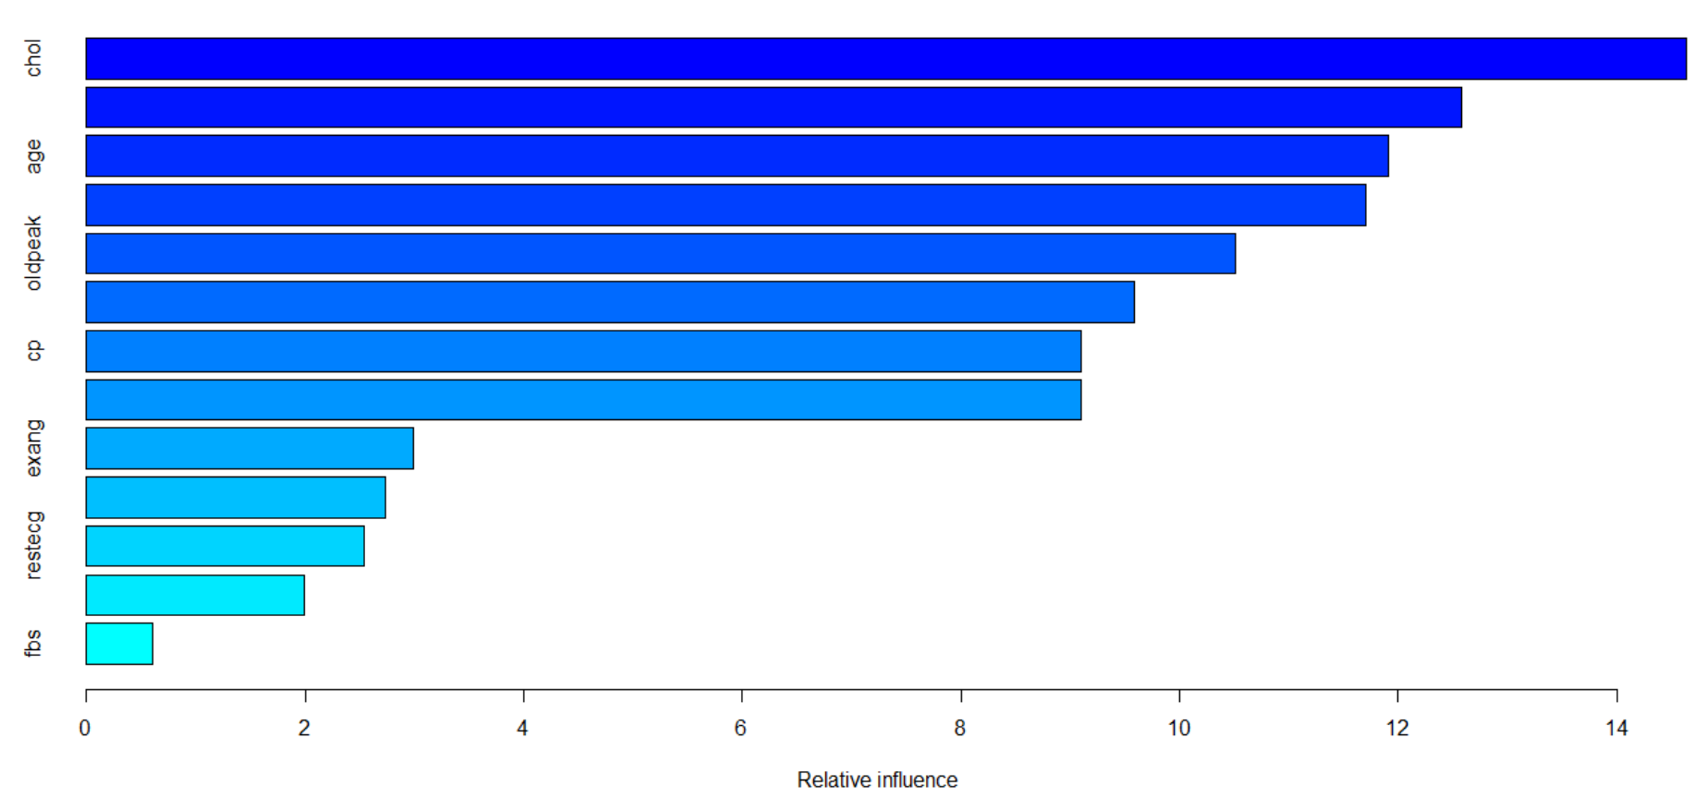
Boosting (Gradient Boosted Model)
Notes:
https://stats.stackexchange.com/questions/51629/multiple-curves-when-plotting-a-random-forest
When there is no test result (ytest was empty for training), plot shows:
for classification, black solid line for overall OOB error and a bunch of colour lines, one for each class' error (i.e. 1-this class recall).
for regression, one black solid line for OOB MSE erro

Slide 21
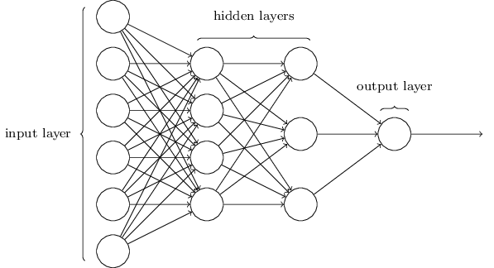
Neural Network
An Artificial Neural Network (ANN) is an information processing paradigm that is inspired by the way biological nervous systems, such as the brain, process information.
It is composed of a large number of highly interconnected processing elements (neurones) working in unison to solve specific problems.
Why Neural Network
Adaptive learning: An ability to learn how to do tasks based on the data given for training or initial experience.
Self-Organisation: An ANN can create its own organisation or representation of the information it receives during learning time.
Real Time Operation: ANN computations may be carried out in parallel, and special hardware devices are being designed and manufactured which take advantage of this capability.

Slide 22
Evaluation Criteria
Split Ratio
Number of Hidden Layers
Algorithms
None
Backpropagation
Resilient Backpropagation
Learning Rate
Linear Output = False (Binary Output)

Slide 23
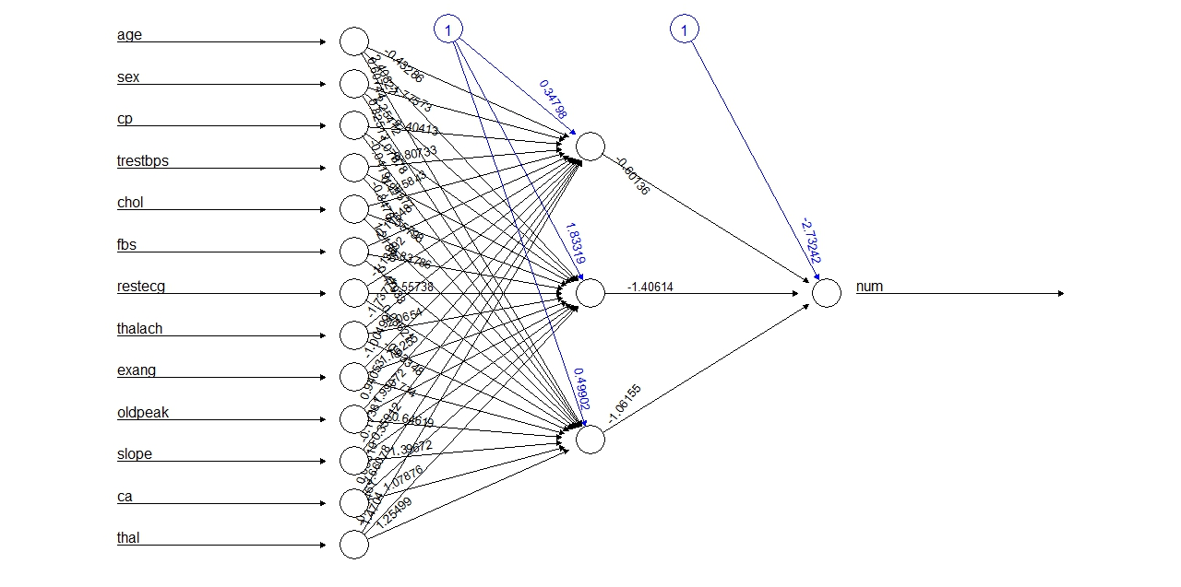
Results
Split Ratio: 70% and 30%
Accuracy on Test Data: 58.42
Predicts only on 1 class

Slide 24
Statlog Heart Disease Dataset
Response Variable
age | sex | cp | trestbps | chol | fbs | restecg | thalach | exang | oldpeak | slope | ca | thal | num
63 | 1 | 1 | 145 | 233 | 1 | 2 | 150 | 0 | 2.3 | 3 | 0 | 6 | 0
67 | 1 | 4 | 160 | 286 | 0 | 2 | 108 | 1 | 1.5 | 2 | 3 | 3 | 1
Attributes → 14
Characteristics: Categorical, Integer and Real
Instances →270

Slide 25
Logistic Regression

Slide 26
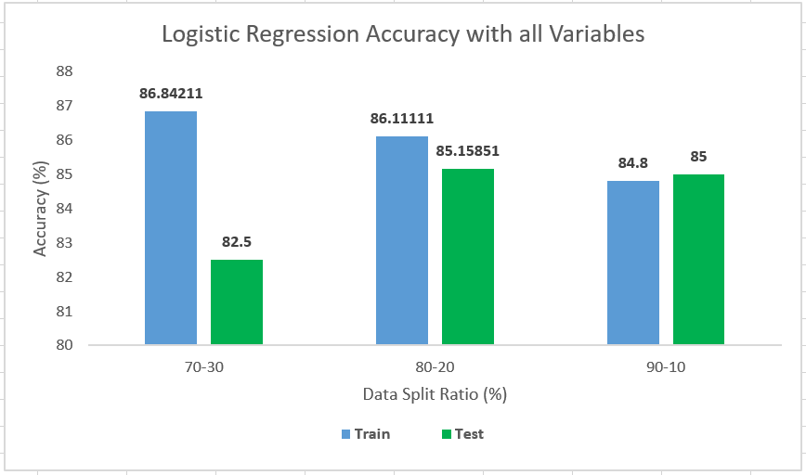
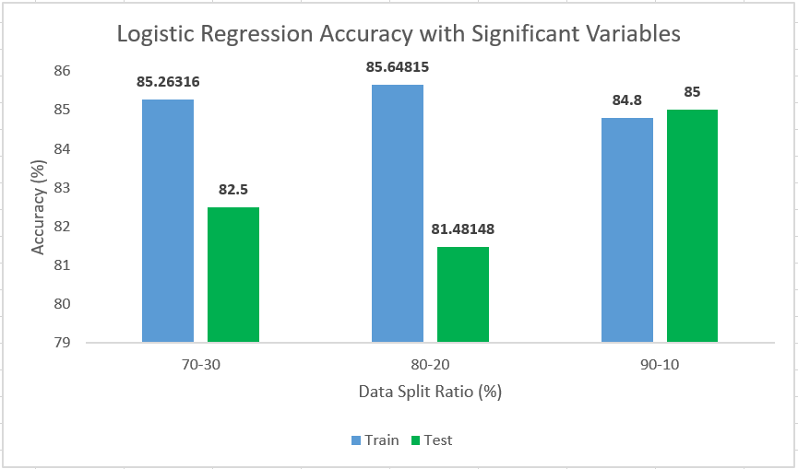
Accuracy: Train and Test
All Variables
Significant Variables

Slide 27
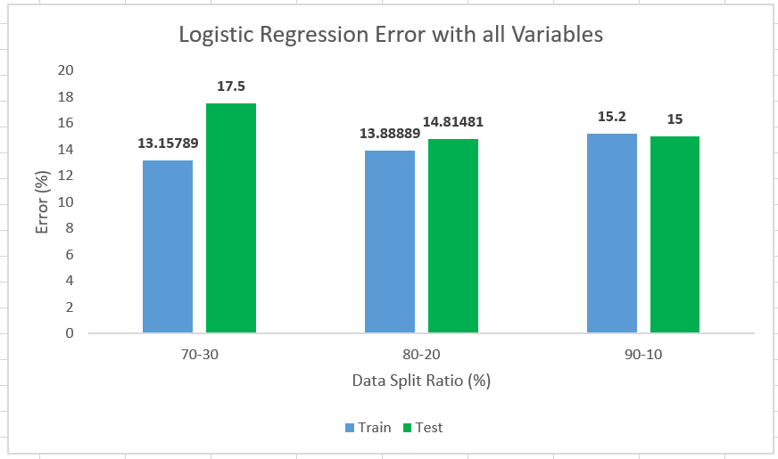
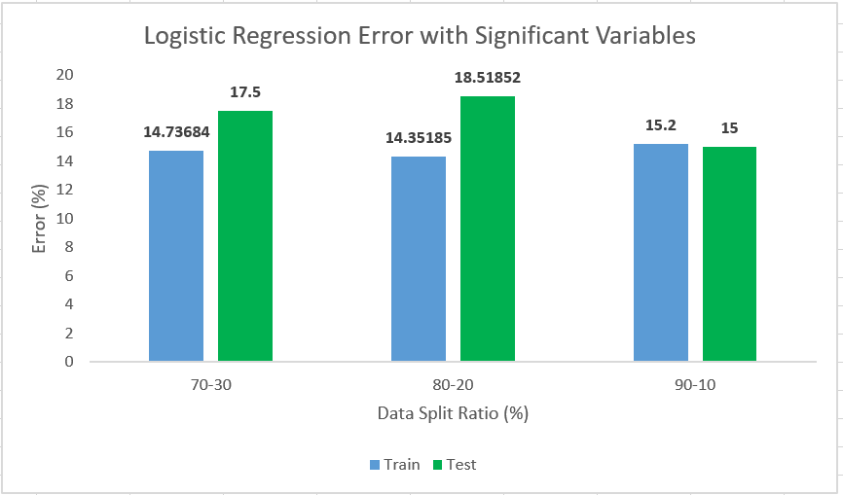
Error: Train Vs Test
All Variables
Significant Variables

Slide 28
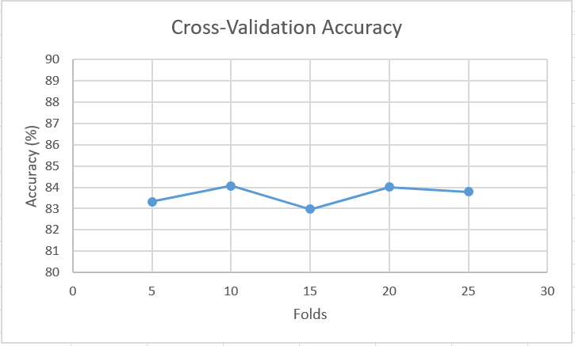
Cross Validation

Slide 29
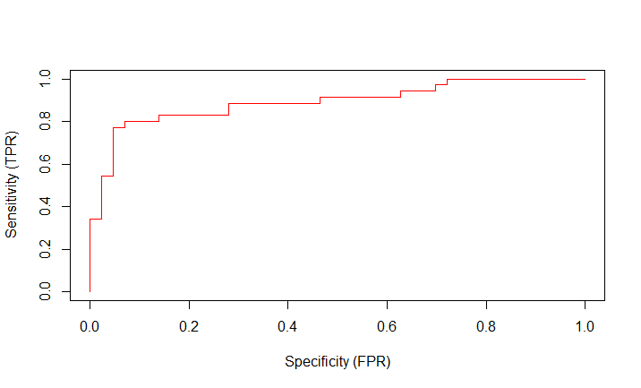
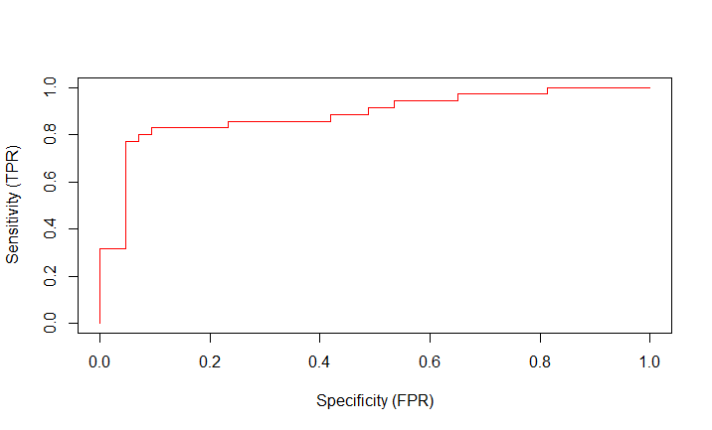
AUC
All Variables
Significant Variables
AUC: 89.1%
AUC: 88.43%

Slide 30
Decision Trees

Slide 31
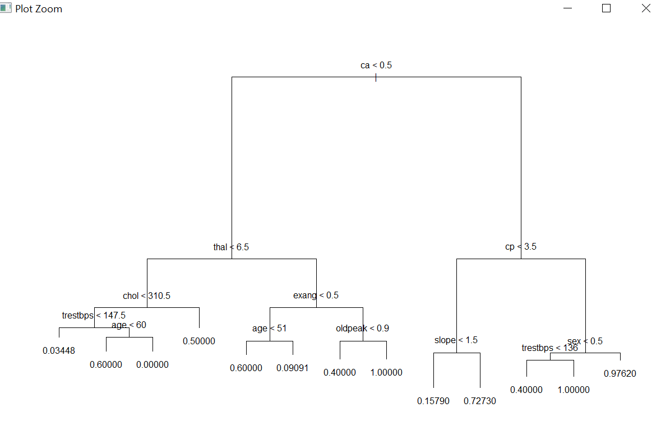
Results
Fully Grown Tree
Test Error: 15%

Slide 32
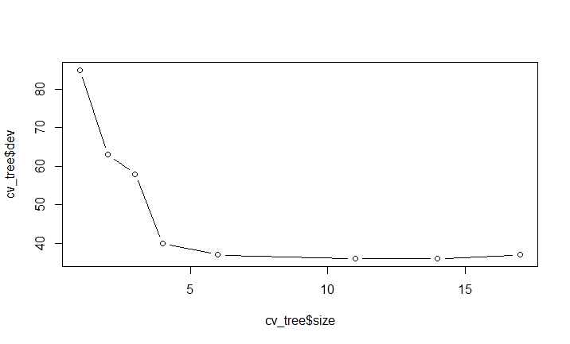
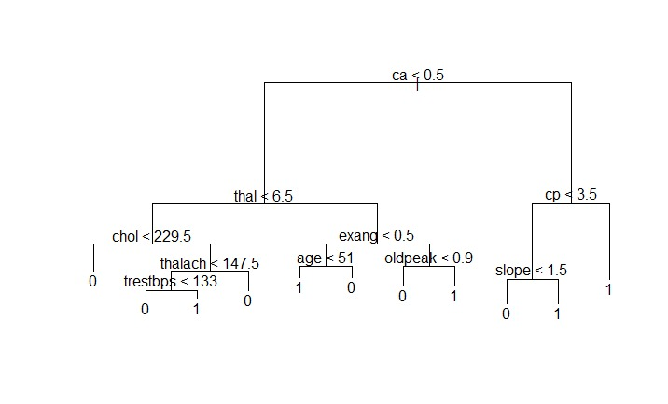
Results
Pruning Criteria
Pruned Tree
Best: 11
Error: 13.75%

Slide 33
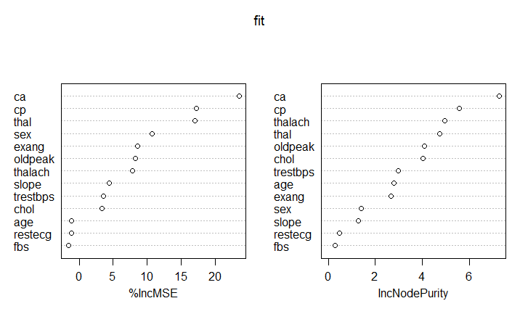
Bagging

Slide 34
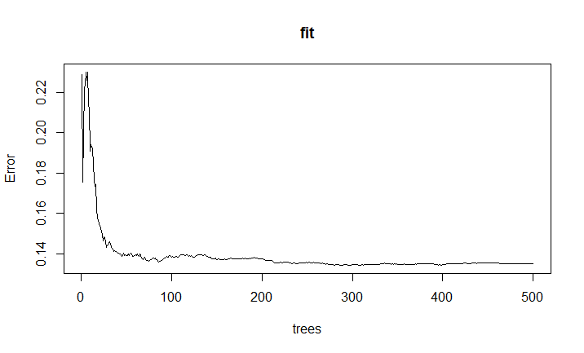
Random Forest (Bagging)
Tree-Size: 500
Error before: 14%
Error after: 11.35%
Notes:
https://stats.stackexchange.com/questions/51629/multiple-curves-when-plotting-a-random-forest
When there is no test result (ytest was empty for training), plot shows:
for classification, black solid line for overall OOB error and a bunch of colour lines, one for each class' error (i.e. 1-this class recall).
for regression, one black solid line for OOB MSE erro

Slide 35
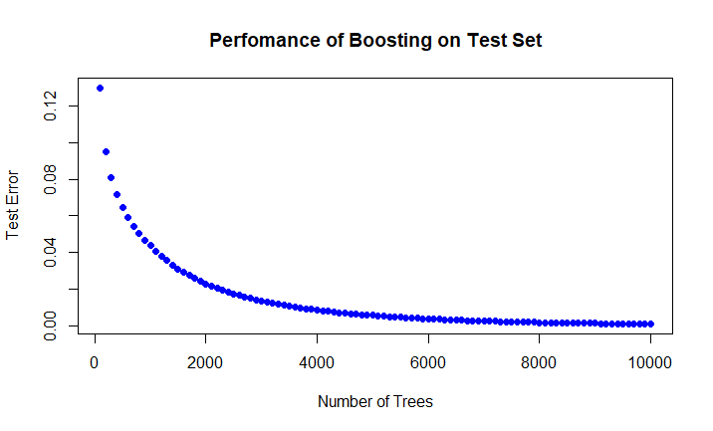
Boosting (Gradient Boosted Model)
100 | 200 | 300 | 400 | 500 | 600
0.13019937 | 0.09536535 | 0.08099631 | 0.0718132 | 0.06482373 | 0.0593525
Notes:
https://stats.stackexchange.com/questions/51629/multiple-curves-when-plotting-a-random-forest
When there is no test result (ytest was empty for training), plot shows:
for classification, black solid line for overall OOB error and a bunch of colour lines, one for each class' error (i.e. 1-this class recall).
for regression, one black solid line for OOB MSE erro

Slide 36
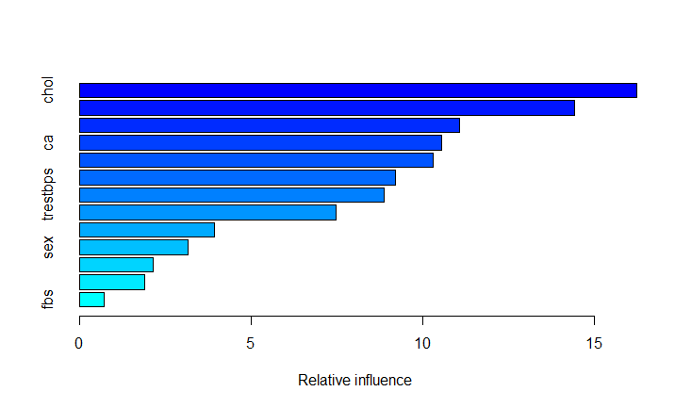
Boosting (Gradient Boosted Model)
Notes:
https://stats.stackexchange.com/questions/51629/multiple-curves-when-plotting-a-random-forest
When there is no test result (ytest was empty for training), plot shows:
for classification, black solid line for overall OOB error and a bunch of colour lines, one for each class' error (i.e. 1-this class recall).
for regression, one black solid line for OOB MSE erro

Slide 37
Neural Network

Slide 38
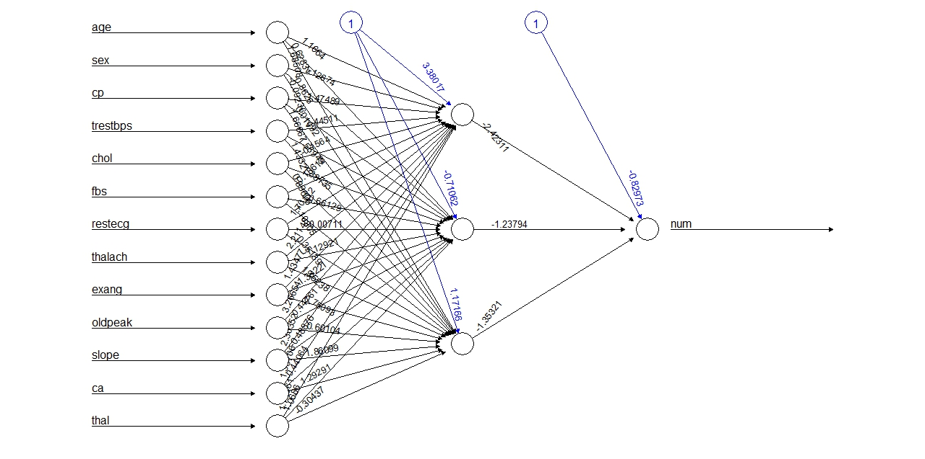
Results
Split Ratio: 70% and 30%
Accuracy on Test Data: 50.23%
Predicts only on 1 class

Slide 39
Spect Heart Disease Dataset
Response Variable
Features → 23
Characteristics: Categorical, Integer and Real
Dataset Division Given:
Train: 80
Test 187

Slide 40
Logistic Regression

Slide 41
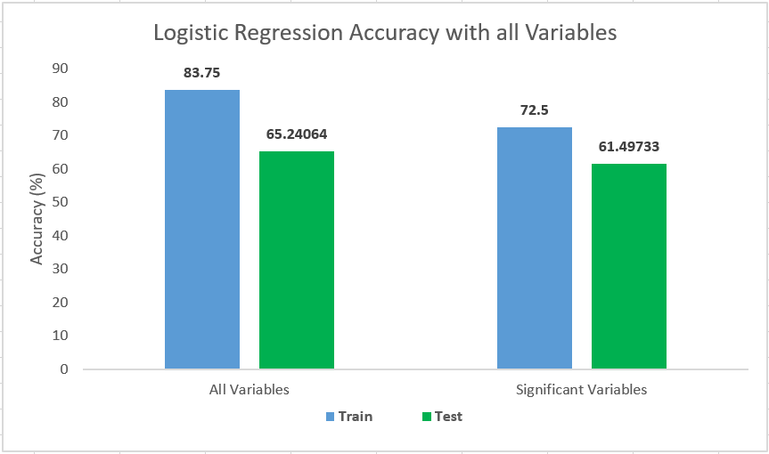
Accuracy: Train and Test
All Variables Vs Significant Variables

Slide 42
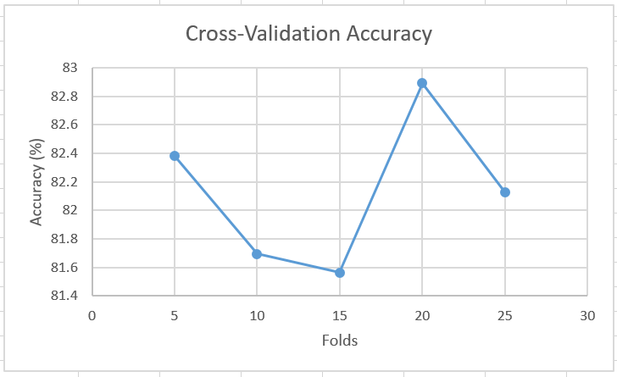
Cross Validation after Merging Train and Test Dataset

Slide 43
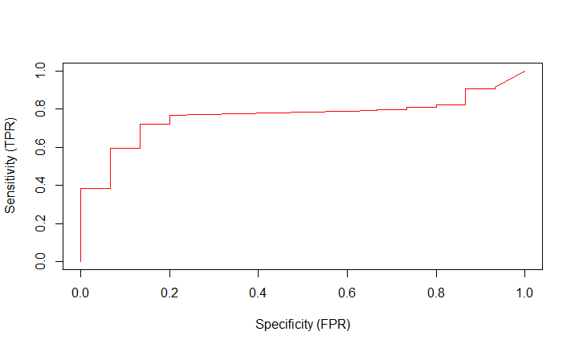
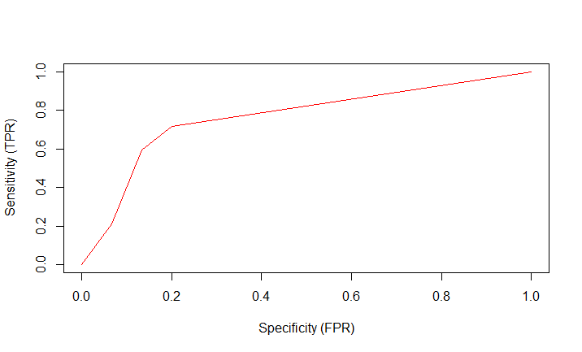
AUC
All Variables
Significant Variables
AUC: 76.25%
AUC: 76.33%

Slide 44
Decision Trees

Slide 45
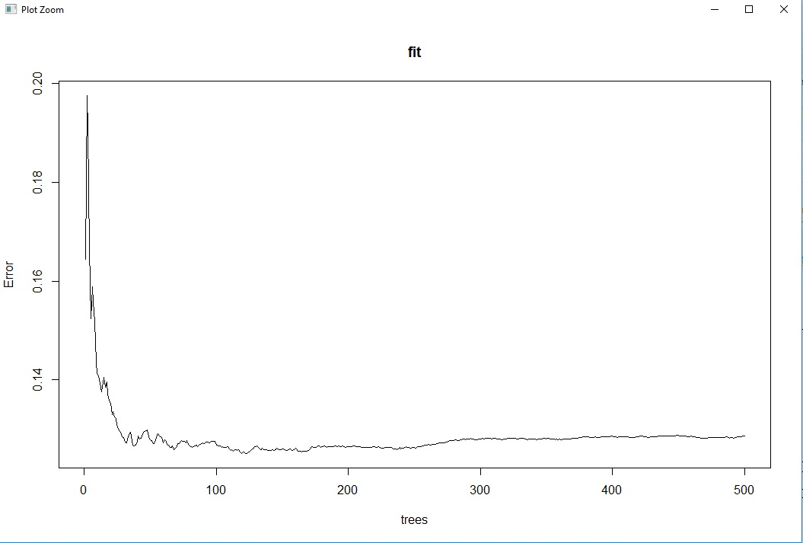
Random Forest (Bagging)
Tree-Size: 500
Error before: 12.5%
Error after: 10.69%
Notes:
https://stats.stackexchange.com/questions/51629/multiple-curves-when-plotting-a-random-forest
When there is no test result (ytest was empty for training), plot shows:
for classification, black solid line for overall OOB error and a bunch of colour lines, one for each class' error (i.e. 1-this class recall).
for regression, one black solid line for OOB MSE erro

Slide 46
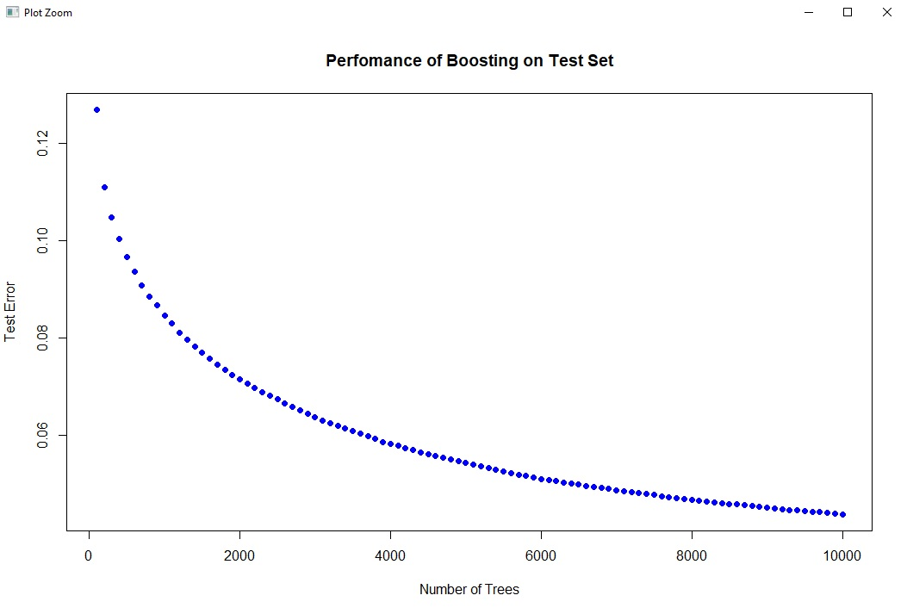
Boosting (Gradient Boosted Model)
100 | 200 | 300 | 400 | 500 | 600
0.12693867 | 0.11108158 | 0.10477958 | 0.10036931 | 0.09671031 | 0.09361668
Notes:
https://stats.stackexchange.com/questions/51629/multiple-curves-when-plotting-a-random-forest
When there is no test result (ytest was empty for training), plot shows:
for classification, black solid line for overall OOB error and a bunch of colour lines, one for each class' error (i.e. 1-this class recall).
for regression, one black solid line for OOB MSE erro

Slide 47
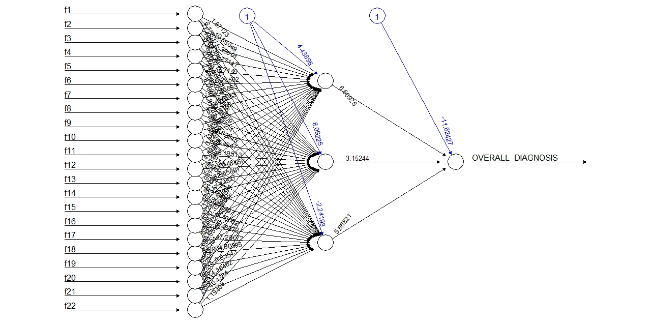
Neural Network

Slide 48
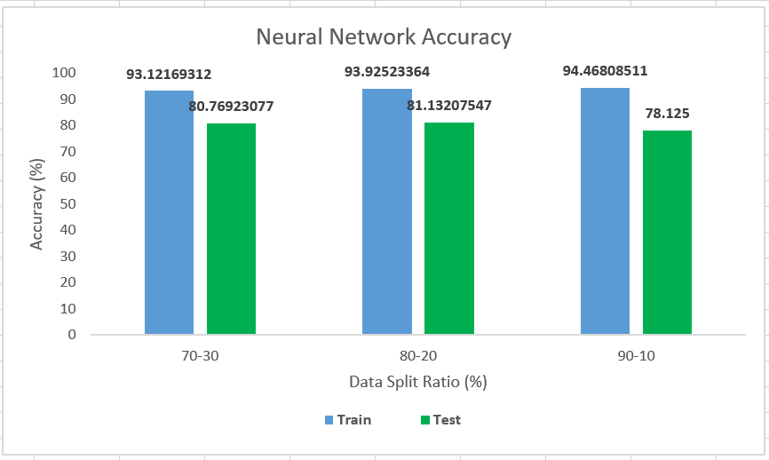
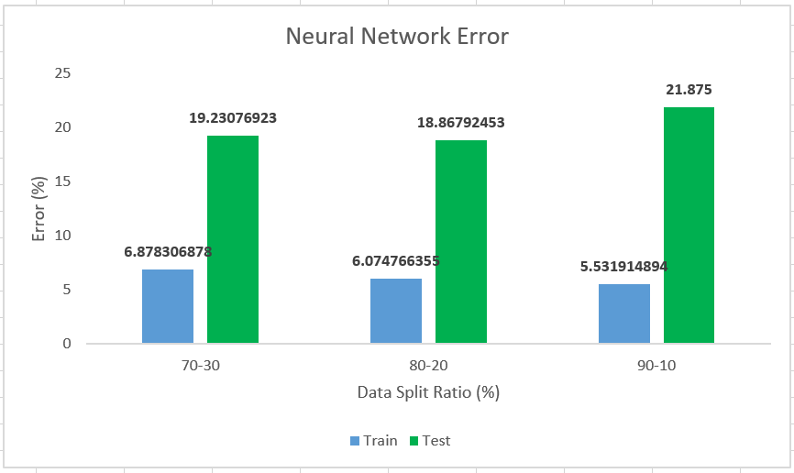
Results

Slide 49
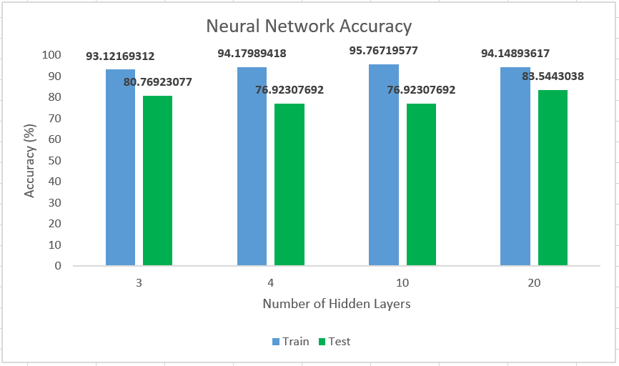
Results

Slide 50
Literature Review
Paper 1: Heart Disease Prediction using Machine Learning and Data Mining Technique
Cleveland Database Used
Compared 3 algorithms based on Decision Tree Classification:
J48 with Reduced-Error Pruning
Extension of the ID3 (Iterative Dichotomiser) model
One of the fastest pruning methods; produces accurate and small decision rules
Disadvantages: Large Space complexity and size of J48 trees
J48 rules slow for large and noisy datasets

Slide 51
Literature Review
Logistic Model Tree
Cost-complexity pruning
Uses cross validation for more stable results
Significantly Slower than other algorithms
Random Forest
Ensemble classifier, consisting of many decision trees
Improvisation over Bagging Algorithm
Combines with random selection of classifiers to construct decision trees with controlled variations

Slide 52
Literature Review
Paper 2: Classification and Prediction of Heart Disease Risk Using Data Mining Techniques of Support Vector Machine and Artificial Neural Networks
Datasets used: Cleveland (MultiClass) and Statlog (Two-Class)
Analyze prediction variability of two class and multiclass problems
2 Algorithms used and compared
Support Vector Machine
Used to classify data, mainly used for two classes
Utilizes both linear & non-linear kernel functions

Slide 53
Conclusion
Cleveland and Statlog
Since both datasets are vey similar
Logistic Regression and Decision Tree works best
Since Binary Classification
Balanced Dataset
SPECT
Neural Networks work best
Since the dataset consist of features
Logistic Regression and Decision Tree don’t work
Consist of Features and not Demographic data
Due to Imbalance Dataset

Slide 54
Contribution
Kevin D’Cruz
Background research
Research on Data Selection
Implementation
Chetan Kumar
Tools, Libraries and Packages
Implementation
Project Report
Abhishek Manoj Kumar
Implementation
Research on Methodology
Project Report
Madhuri Gawali
Research on Method Selection
Project Report
Apoorva Shivashankar
Literature Review
Project Report

Slide 55
References
Heart Disease Prediction Using Machine learning and Data Mining Technique: http://csjournals.com/IJCSC/PDF7-1/18.%20Tejpal.pdf
Intelligent and Effective Heart Disease Prediction System using Weighted Associative Classifiers: http://citeseerx.ist.psu.edu/viewdoc/download?doi=10.1.1.302.6636&rep=rep1&type=pdf
Classification and prediction of heart disease risk using data mining techniques of Support Vector Machine and Artificial Neural Network: http://ieeexplore.ieee.org/document/7724835/
Diagnosis of heart disease patients using fuzzy classification technique: http://ieeexplore.ieee.org/document/7066746/
Knowledge discovery approach to automated cardiac SPECT diagnosis: http://citeseerx.ist.psu.edu/viewdoc/download?doi=10.1.1.17.3773&rep=rep1&type=pdf
Lecture Slides
https://www.medcalc.org/manual/logistic_regression.php
https://en.wikipedia.org/wiki/Logistic_regression#/media/File:Linear_regression.svg
https://www.doc.ic.ac.uk/~nd/surprise_96/journal/vol4/cs11/report.html

